Slide 1

Smart Helmet: Automatic Fall Detection & SOS System
A revolutionary safety project enhancing rider protection through instant emergency alerts
SafeVerse Team: Aditi Gupta, Maanit Gulia, Lavya Jain, Kunal Kapur

Slide 2

The Critical Gap in Rider Safety
Solo Rider Vulnerability
The Golden Hour Crisis
Riders traveling alone face heightened risk when accidents occur with no witnesses nearby to provide immediate assistance.
Every minute counts after impact. Delayed medical response dramatically reduces survival rates and increases severity of injuries.
Manual Systems Fail
Traditional emergency calls require conscious action. Unconscious riders cannot seek help, creating a dangerous gap in emergency response.

Slide 3
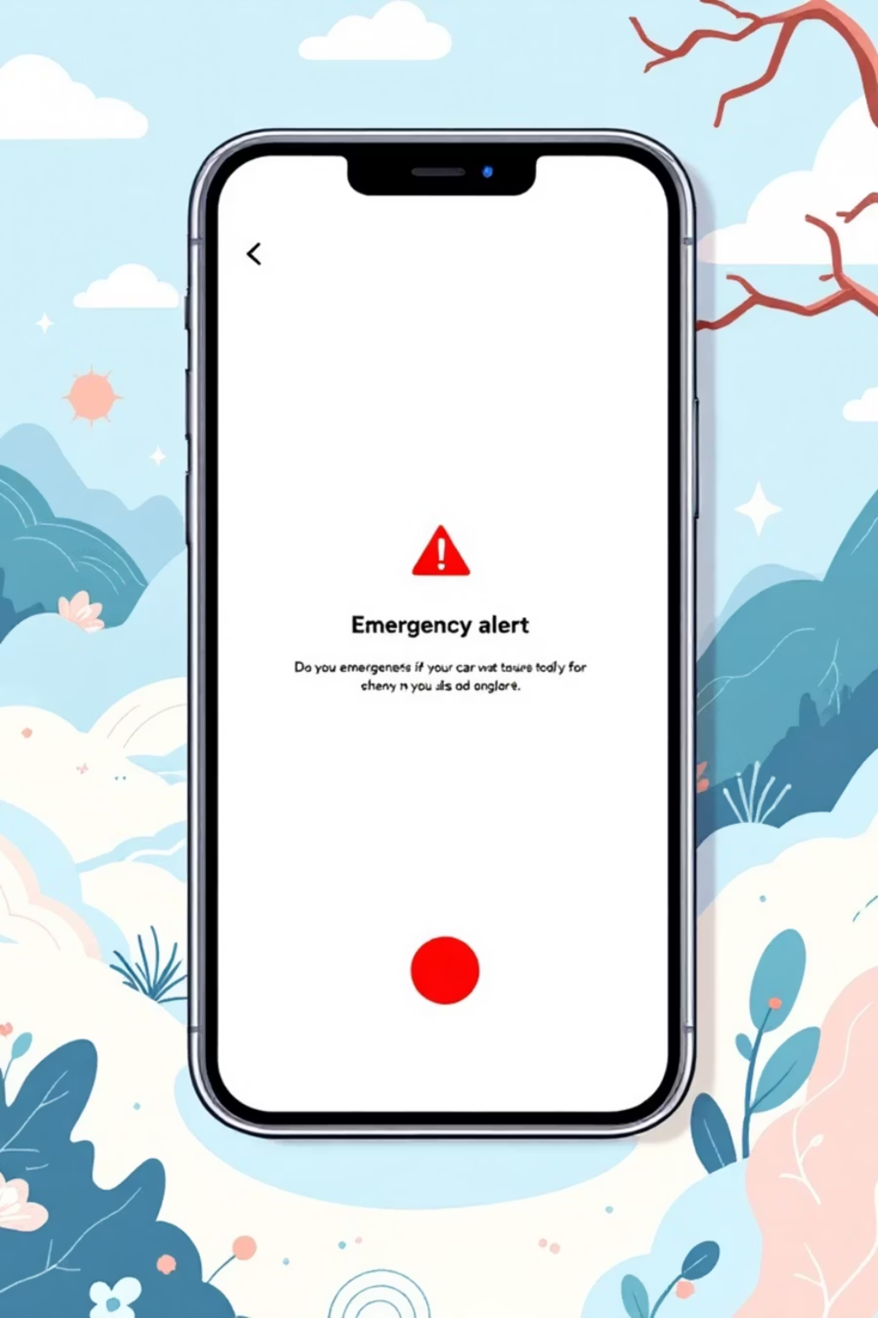



Our Solution: An Intelligent, Automated Safety Net
Zero Human Interaction Required
Our smart helmet system automatically detects crashes the instant they occur, eliminating the need for rider intervention. The moment impact is sensed, the system springs into action.
Instant Alerts Transmitted
Leveraging cloud-based API integration, instant SMS alerts are transmitted to emergency contacts with critical information—all happening in seconds, not minutes.
Life-Saving Outcomes
Help arrives faster, lives are saved, and families receive immediate notification when it matters most.

Slide 4
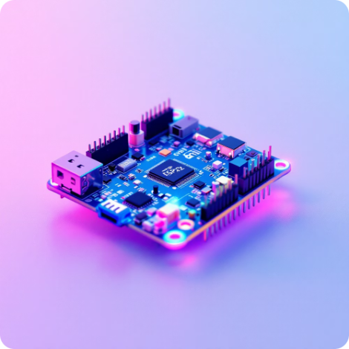

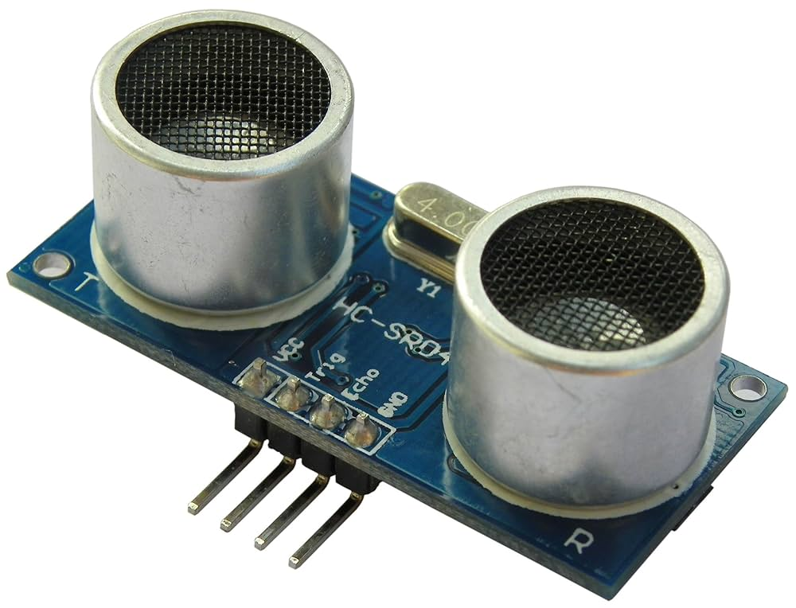



The Core Components
Our system is built with a selection of affordable, reliable, and high-performance components.
ESP32 Microcontroller
Motion Sensor (PIR)
Ultrasonic Sensor (HC-SR04)
Power Bank
Brain of the system with WiFi connectivity and processing power
Detects movement and orientation changes for crash detection
Portable power supply for extended operation
Measures distance and detects sudden position changes
Cloud Platform Integration
Instant SMS Alerts
Our prototype is fully operational via serial monitor, with API integration ready to deploy. Only an API key and ID are needed for complete real-time data transmission.
Leveraging this robust cloud integration, the system transmits instant SMS alerts to emergency contacts with critical information the moment a crash is detected.

Slide 5
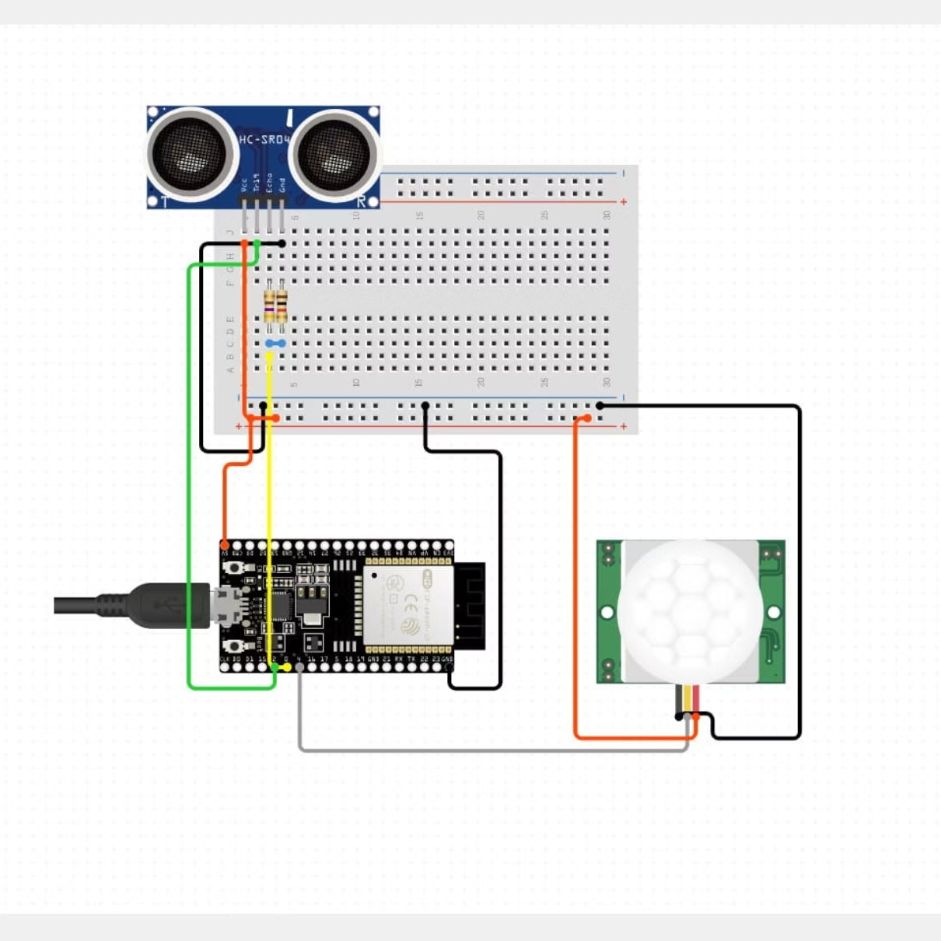
CIRCUIT DIAGRAM :

Slide 6




How It Works: A 4-Step Safety Net
A simple yet highly effective data flow ensures rapid response precisely when it's needed most. Our system operates through four seamless stages.
SENSE & MONITOR
PROCESS & CONFIRM
The helmet's integrated motion and ultrasonic sensors continuously monitor the rider's movement and proximity to the ground.
In the event of an impact, the ESP32 microcontroller instantly analyzes data from both sensors to confirm a genuine crash and eliminate false alarms.
CONNECT & ACTIVATE
ALERT & RESCUE
Once a crash is confirmed, the ESP32 uses its built-in WiFi to connect to a cloud-based API, activating the emergency protocol.
The system automatically sends an instant SMS alert to pre-saved emergency contacts, ensuring help can be dispatched immediately without any action from the rider.

Slide 7
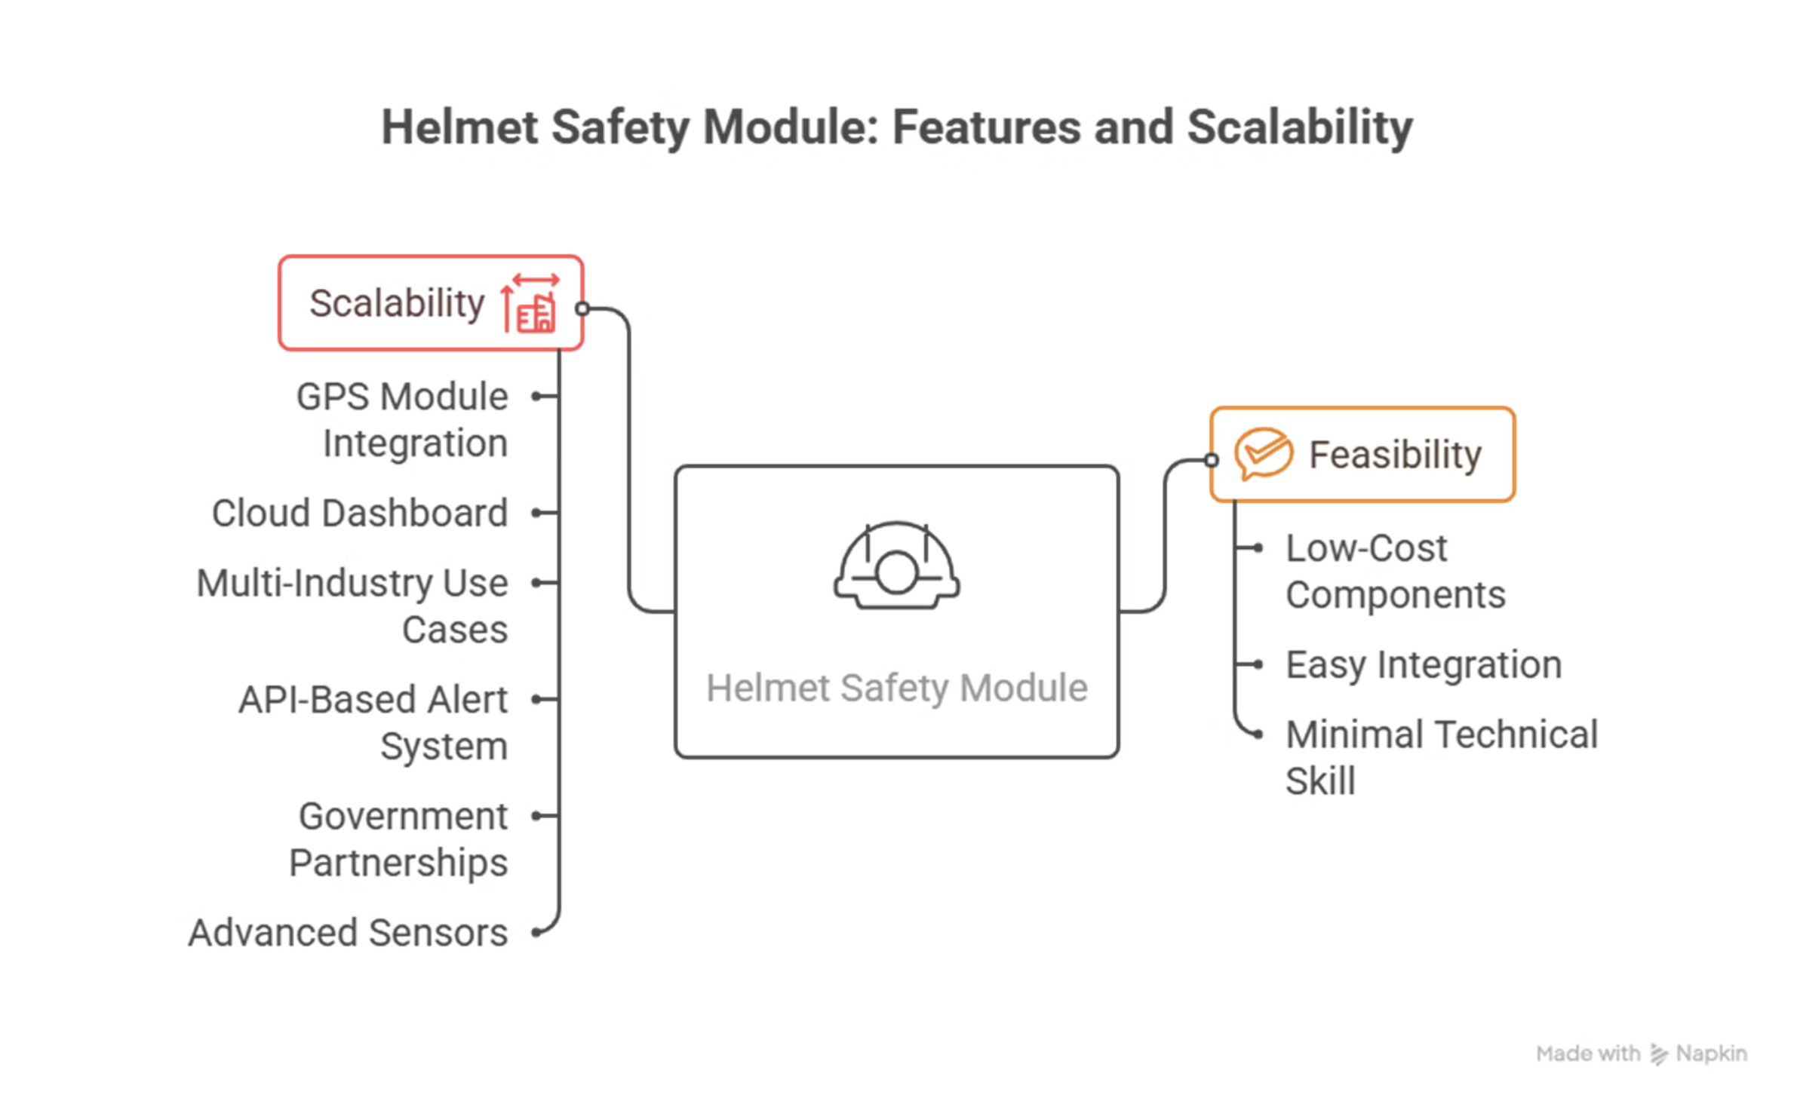
Feasibility

Slide 8





Future Aspects: The Journey Ahead
Phase 1: Current System Optimization
Fine-tune the dual-sensor crash detection algorithm (ultrasonic + motion sensor)
Optimize the 5-meter proximity detection range for various crash scenarios
Phase 2: Enhanced Sensor Accuracy
Improve motion threshold calibration to reduce false positives
Implement advanced filtering algorithms for motion sensor data
Complete API integration for SMS alerts
Add multiple distance measurement points for better crash validation
Develop machine learning models to distinguish crash patterns from normal riding
Phase 3: Location & Communication Upgrade
Integrate GPS module for precise crash location sharing
Add backup power systems for extended operation
Implement multi-channel alert system (SMS, WhatsApp, calls)
Add emergency services direct notification capability
Phase 4: Smart Analytics Platform
Develop companion mobile app for contact management
Create cloud dashboard for real-time helmet monitoring
Implement crash severity assessment based on sensor data
Phase 5: Market Expansion & Integration
Add predictive maintenance alerts for helmet components
Adapt system for different helmet types and vehicles
Develop fleet management system for commercial use
Expand to industrial safety applications (construction, mining)
Partner with insurance companies for premium discounts
Scale to international markets with local emergency services integration

